Slide 1

Excelerate
Final Presentation
Present Meaningful insights
Team 21
By Doman Lal
Submitted to,

Slide 2
Applicant, Outreach & Campaign Analysis
Data Validation, Insights & Recommendations

Slide 3
1. Project Overview
Applicant Data: 19,338 records (Country, University, Contact).
Campaign Data: 23 campaigns (Category, Status, Intake, University).
Outreach Data: 37,369 records (Caller, Outcome, Escalation, Campaign ID).
Objective: To evaluate applicant distribution, outreach effectiveness, and campaign performance.

Slide 4
2. Data Validation Approach
Removed duplicates across Applicant & Outreach tables.
Standardized University names for consistency.
Validated Campaign IDs across Campaign & Outreach tables.
Handled missing contact and remark fields.
Outcome: Ensured clean, reliable datasets for analysis.

Slide 5
3. Applicant Insights
Majority applicants from key universities (e.g., IIT, US universities).
Country-wise spread shows dominance of India.
Strong interest in select intakes.

Slide 6
4. Campaign Insights
23 campaigns analyzed across multiple categories.
Active campaigns dominate; few inactive.
Certain universities drive more applicant volume per campaign.

Slide 7
5. Outreach Insights
37K+ outreach attempts logged.
High proportion of positive outcomes recorded.
Escalations required in limited cases.
Month-wise trend shows peak activity during intake months.

Slide 8
6. Combined Analysis
Linked Applicants → Campaigns → Outreach.
Campaigns with stronger outreach had higher applicant engagement.
Universities with targeted campaigns showed improved applicant conversion.
Outcome patterns varied across campaigns.

Slide 9

7. Recommendations
Focus on campaigns with proven outreach effectiveness.
Enhance targeting for top applicant universities.
• Reduce escalation by training callers on FAQs.
• Monitor month-wise outreach to align with intake peaks.

Slide 10
8. Final Summary
Data validation ensured accuracy across 3 datasets.
Key insights derived: applicant hotspots, campaign effectiveness, outreach outcomes.
Recommendations provided to optimize future campaigns.
Outcome: Actionable insights to strengthen recruitment strategy.

Slide 11
Key Metrics
Rows: 37368
Columns: 16
Candidate PKs: None detected

Slide 12
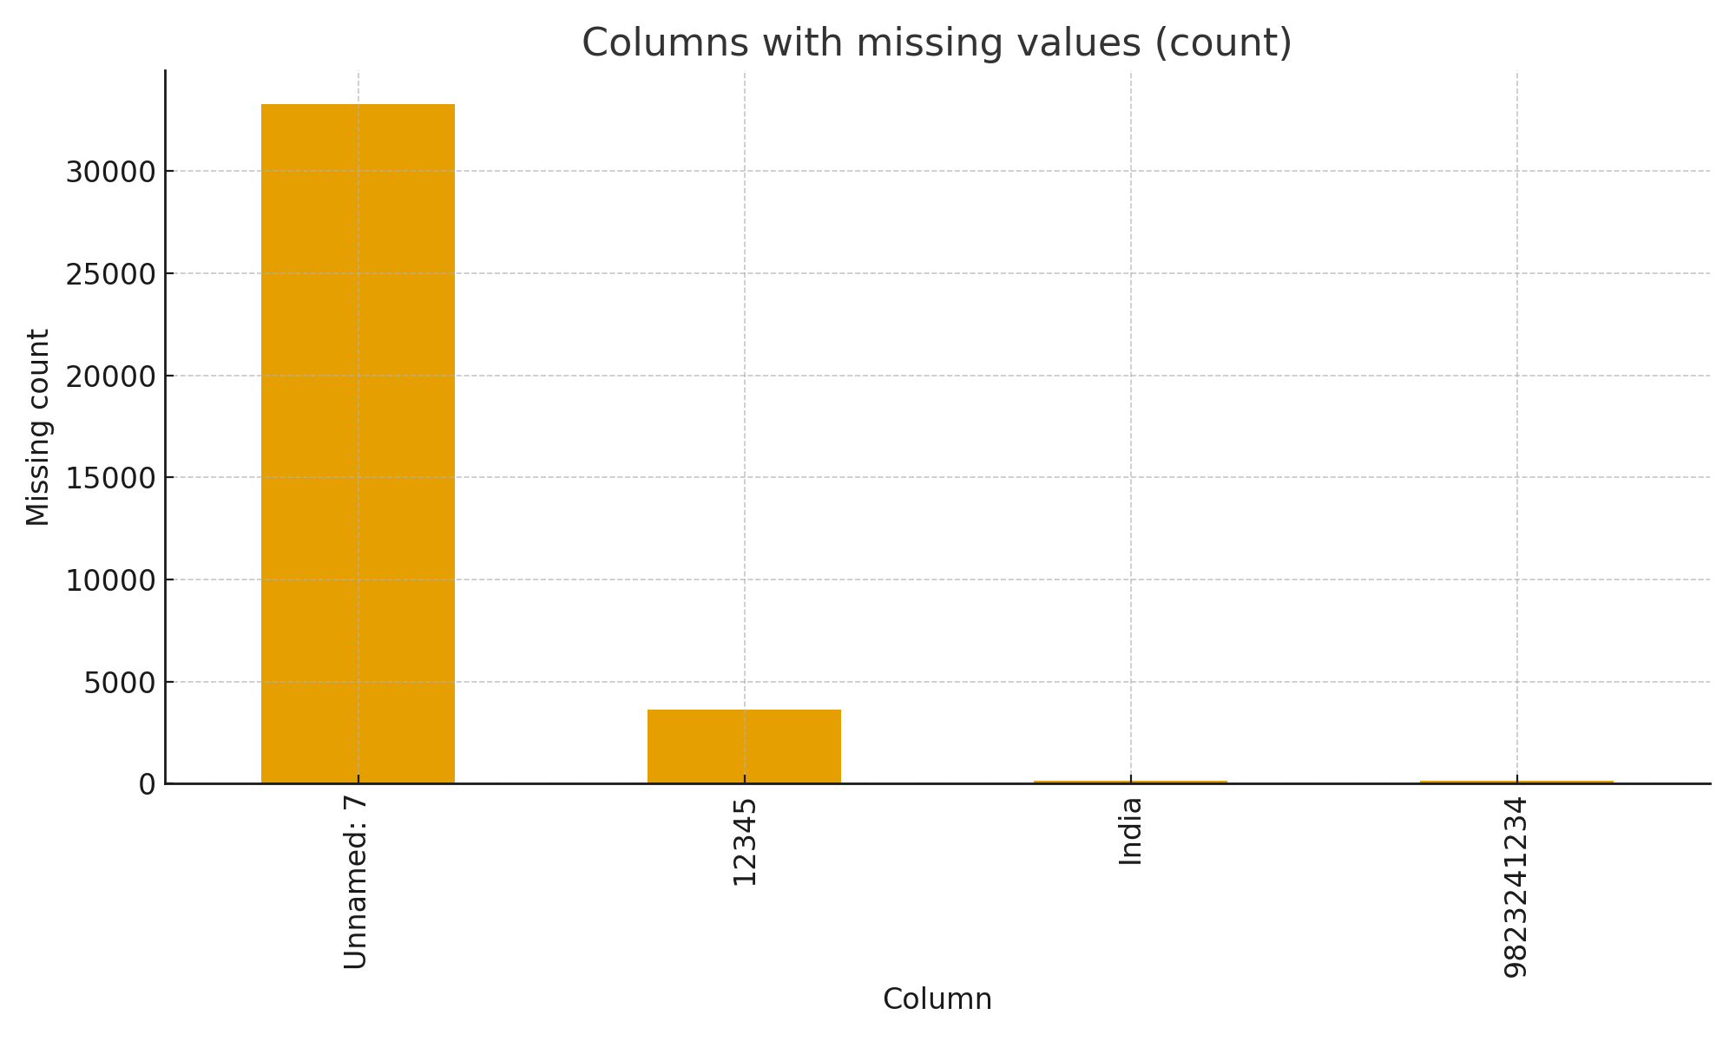
Missing Values

Slide 13
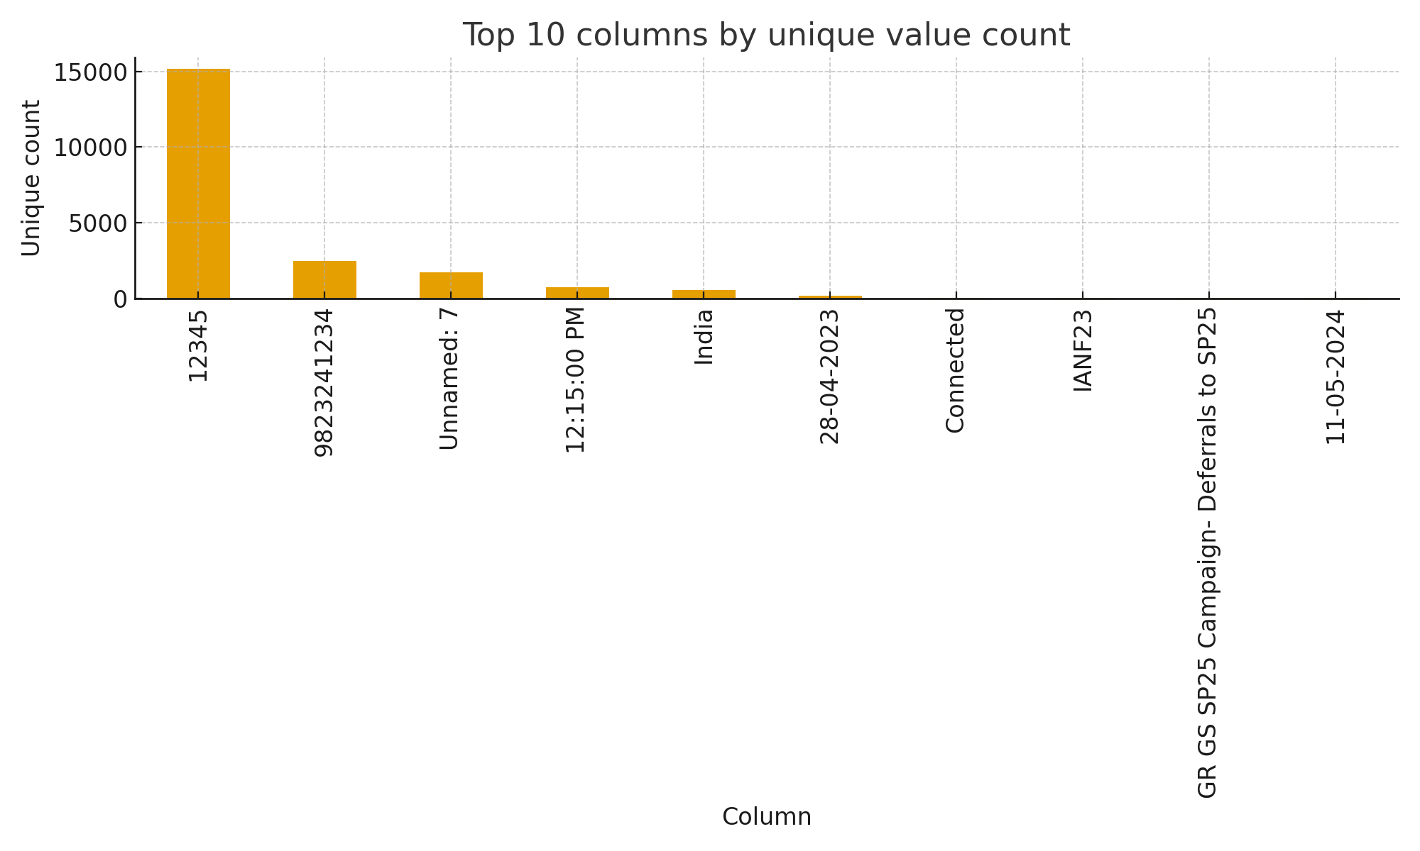
Top Unique Counts

Slide 14
Recommendations
Confirm primary key(s) and enforce uniqueness constraints after cleanup.
Investigate and remediate columns with high null rates (>20%).
Set up scheduled SQL validation jobs and alerts.
Document business rules and add them to ETL tests.

Slide 15
Dashboard Design: Campaign & Outreach Analysis
Google Looker Studio | Visual Storytelling
Charts & Insights

Slide 16
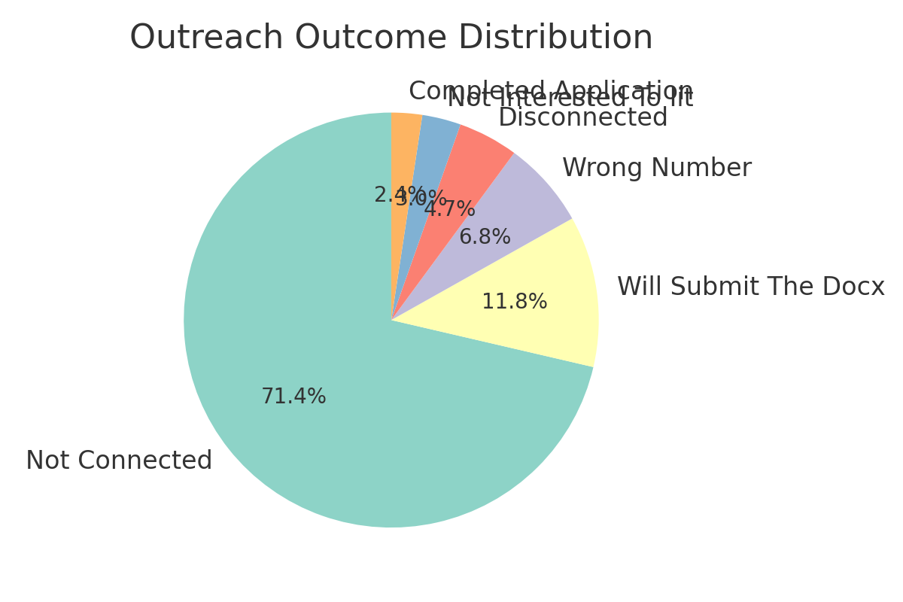
Outreach Outcome Distribution

Slide 17
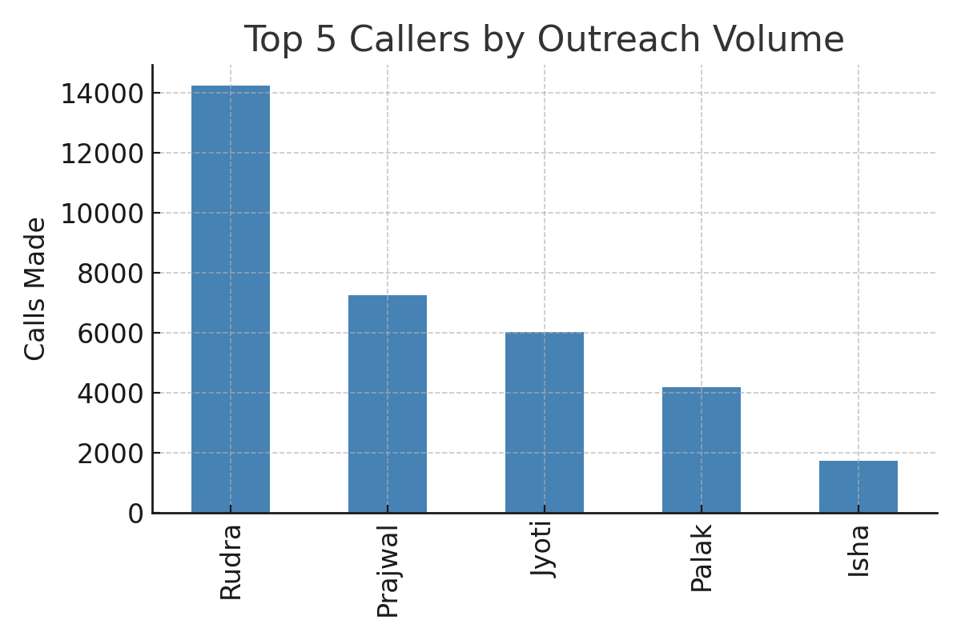
Top 5 Callers by Outreach Volume

Slide 18
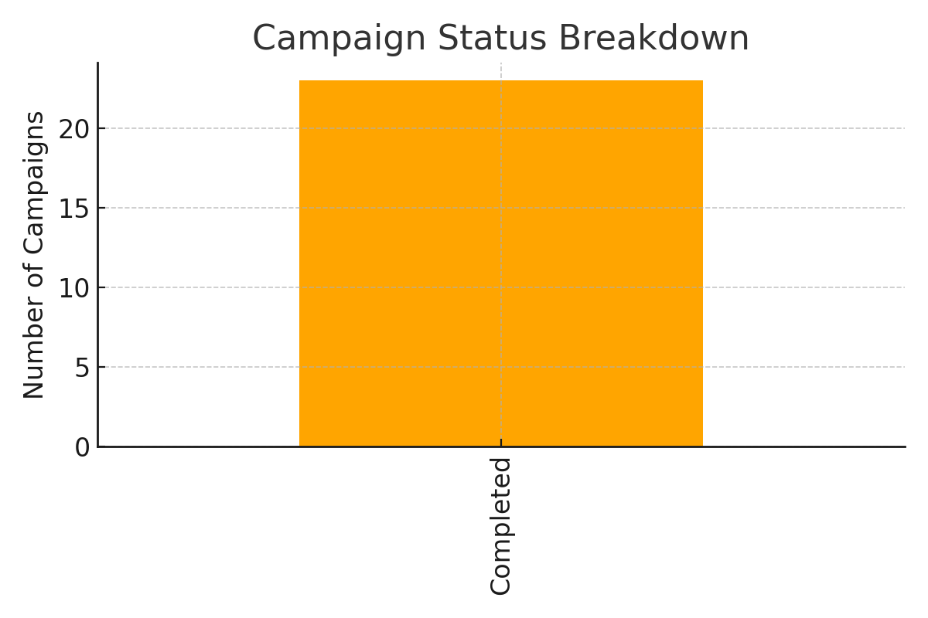
Campaign Status Breakdown

Slide 19
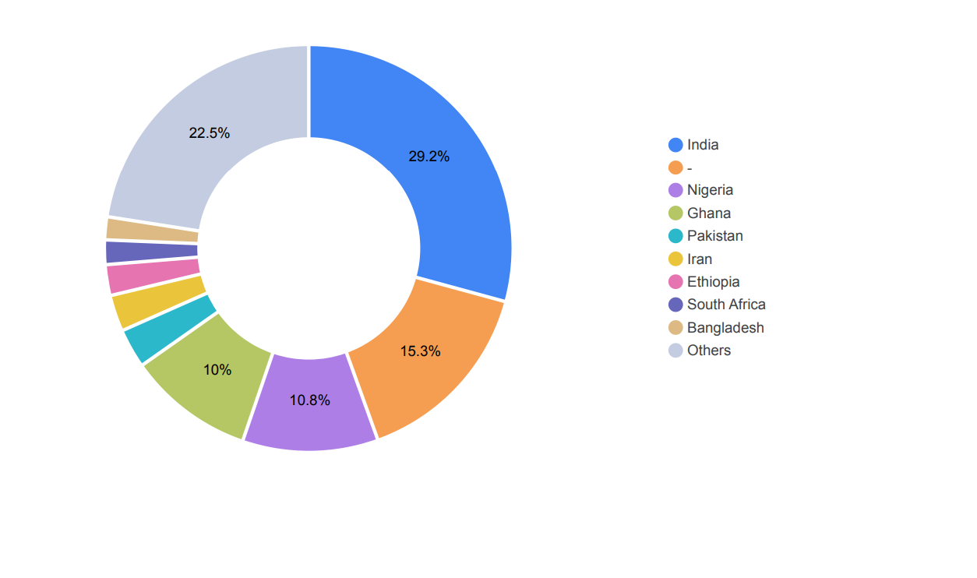
countries and Contribution

Slide 20
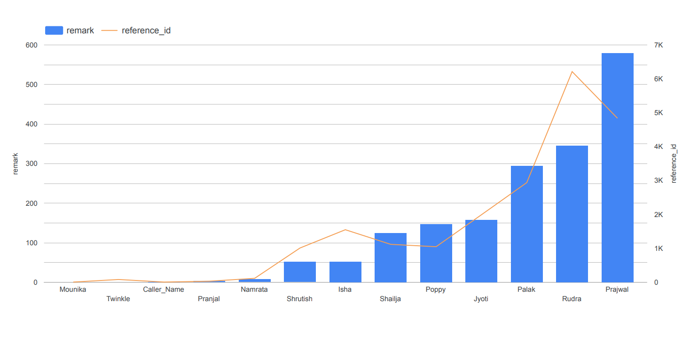
Call made by reference id

Slide 21
Thank You

